Slide 1
Sentiment Analysis of Edmonton Restaurants Near Tourist Spots
(Examining the Impact of Proximity to Attractions on Customer Sentiments)
Presented by: Zhila Mofidi
Date: December 4, 2024

Slide 2
Datasets Used:
- Yelp Business Dataset: 5,573 restaurants in Edmonton.
- Yelp Review Dataset: 58,539 reviews, 18,792 near tourist attractions.
- Edmonton Attractions Dataset: 56 tourist sites.
Statistical Summary:
- Business dataset: average rating ~3.7 stars.
- Review dataset: 82% positive sentiment.
- Complaints: service, pricing, and overall value.

Slide 3
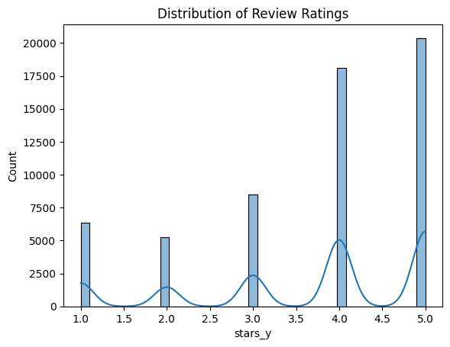
Research Objective Why Sentiment Analysis Matters?
Focus:
Understanding customer feedback to enhance restaurant reputation and competitiveness.
Insight:
The distribution of Yelp ratings for Edmonton restaurants reveals trends in customer sentiment.
Objective:
Analyze Yelp reviews (2008–2021) for Edmonton restaurants near tourist attractions.

Slide 4
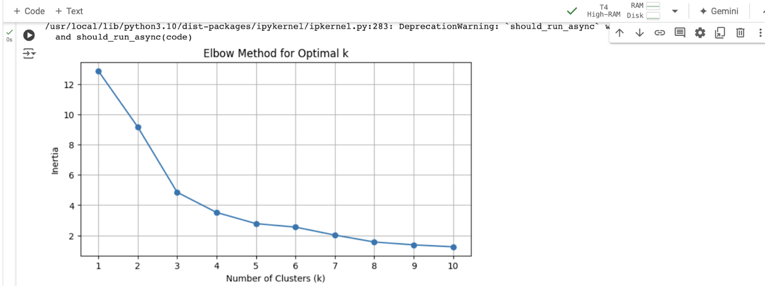
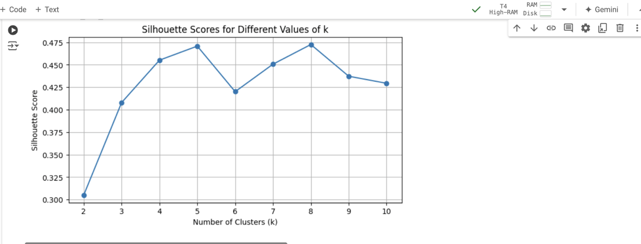
Clustering Analysis Understanding Restaurant Patterns
Methodology:
Applied K-Means clustering.
Analyzed geographic coordinates and ratings.
Results:
Optimal clusters: 6 (determined by Elbow and silhouette Method).
High-rated clusters often near tourist spots.

Slide 5
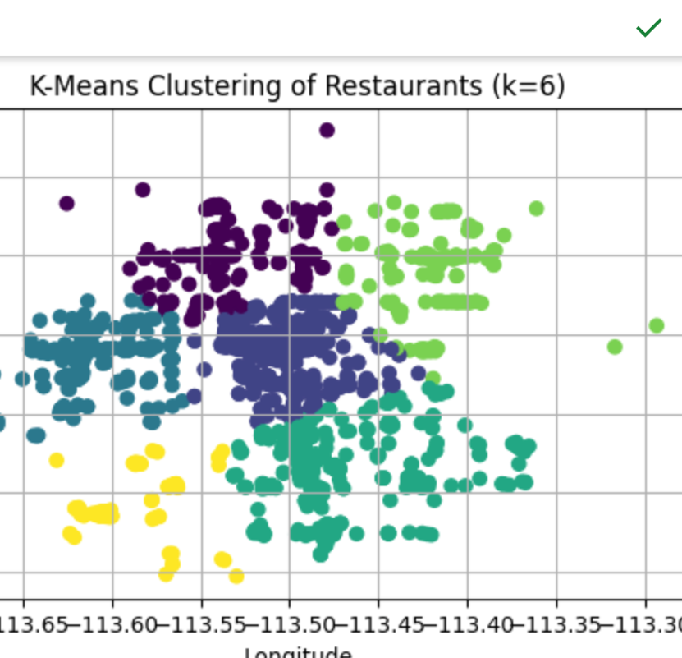
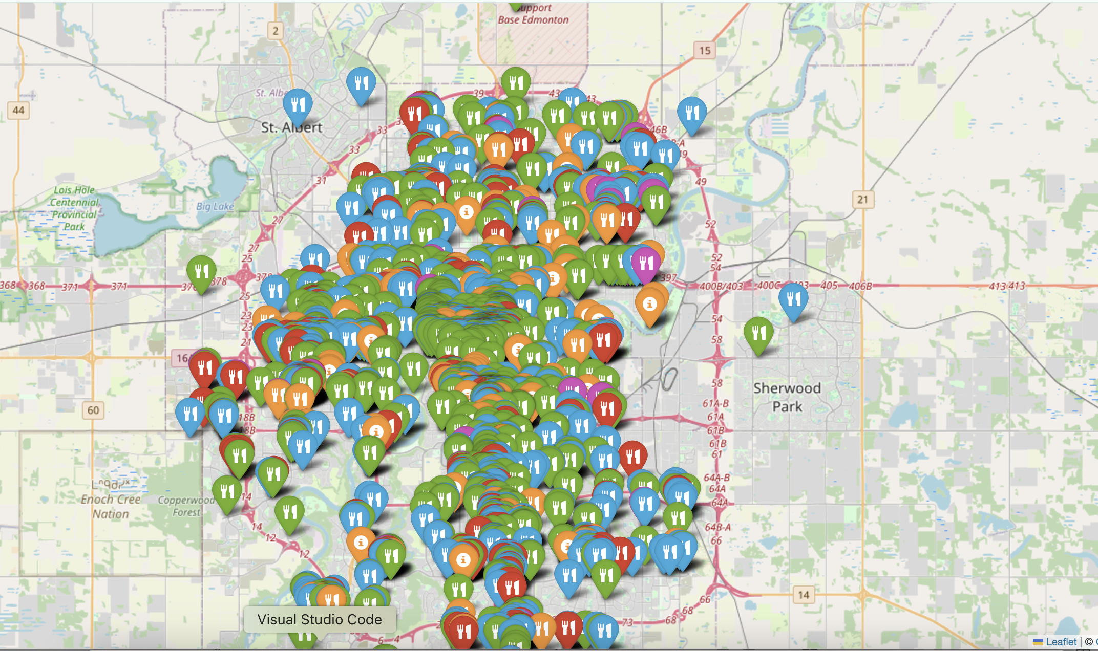
Tool Used: Folium. High-Rated Areas: Near attractions (green markers). Moderate Ratings: Suburban clusters (blue markers). Low Ratings: Farther from attractions (purple markers).
Limitations: K-Means assumes circular clusters, which may not align
with real-world geography.

Slide 6
Research Question 1 - Understanding Customer Sentiments Objective: Identify dominant sentiments in Yelp reviews for restaurants near Edmonton's tourist spots. Focus: Analyze sentiment distribution. Evaluate model performance in capturing nuanced trends. Models Used: BERT: Complex reviews, sarcasm, mixed emotions. VADER: Lexicon-based, effective for short reviews. TextBlob: Quick polarity scoring for baseline insights. Results: 82% positive reviews. Complaints focus on service and pricing. BERT excels at detecting nuanced negative sentiments.

Slide 7
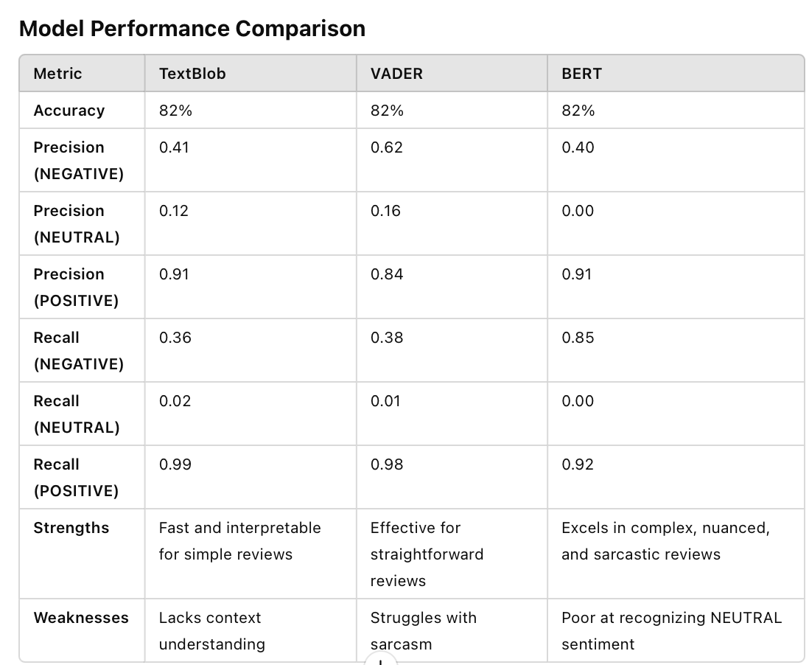

Slide 8
Research Question 2: How does the overall sentiment trend change over time for restaurants near tourist sites, and what are the projected future trends? Objective: using ARIMA, SARIMA, and Prophet models for sentiment stability/fluctuations through 2026. Evaluate the impact of historical external factors (economic downturns, tourism spikes). Data Aggregation: Aggregated yearly average sentiment scores from review data (2008-2021) using pandas. Stationarity Testing: Applied Augmented Dickey-Fuller test to check for stationarity, confirming readiness for ARIMA modeling. The ADF test statistic is -8.9515, which is less than the critical value, and the p-value is below 0.05, indicating the time series is stationary

Slide 9
Historical Trends (2008–2021): Fluctuations due to the 2008 recession, tourism spikes (2013–2014), and COVID-19.
Forecasted Trends (2022–2026):
ARIMA: Stable with minor fluctuations.
SARIMA & Prophet: Gradual decline in sentiment.

Slide 10
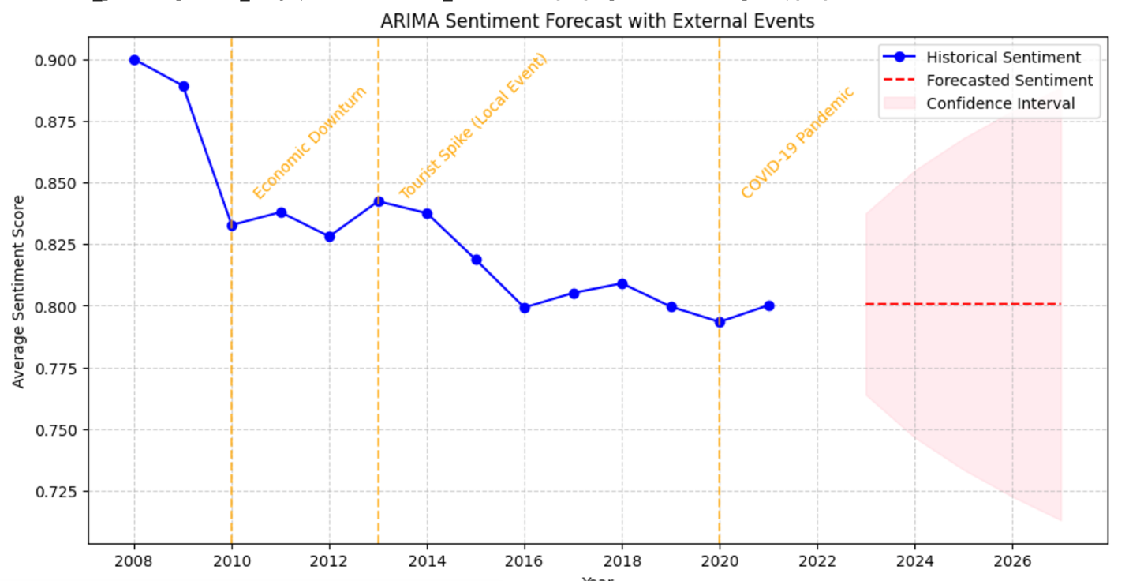
Model Results
ARIMA (0, 1, 0): Forecasts steady trends through 2026.

Slide 11
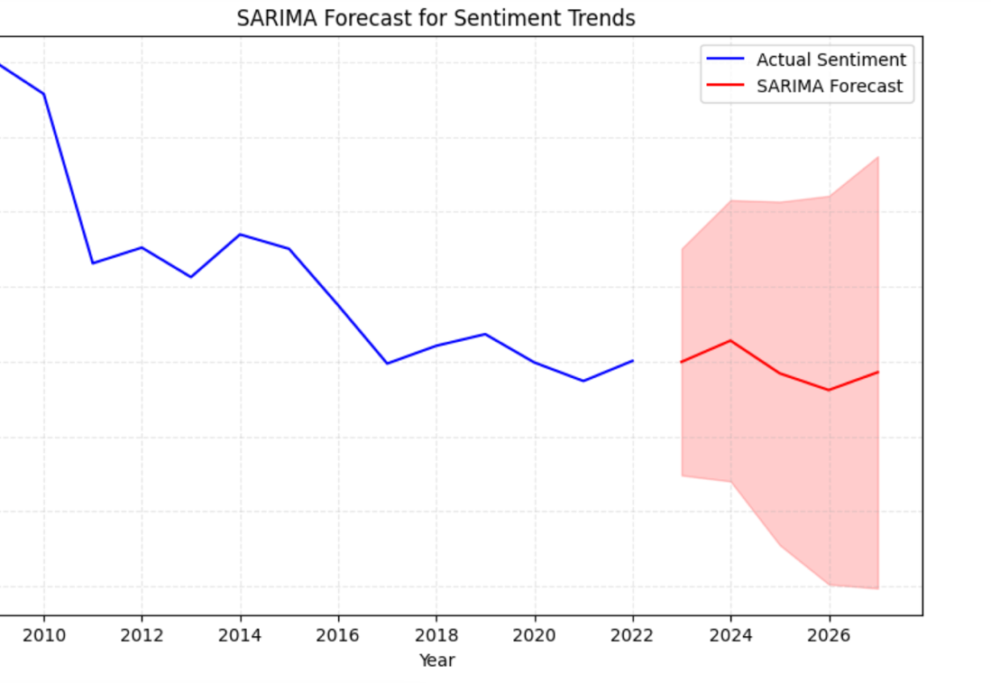
SARIMA: Includes seasonal components for yearly fluctuations.

Slide 12
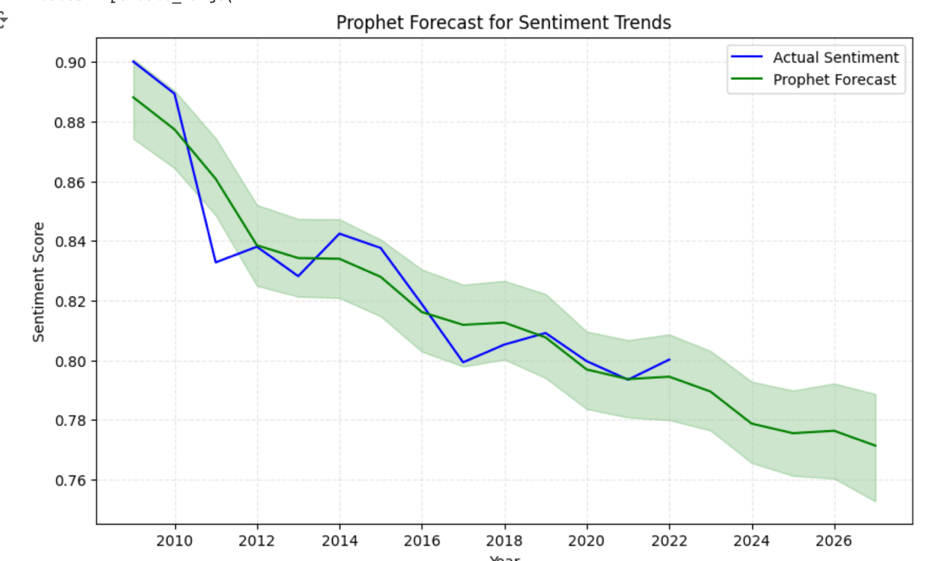
Prophet:Best model for integrating exogenous factors like holidays or major tourist

Slide 13
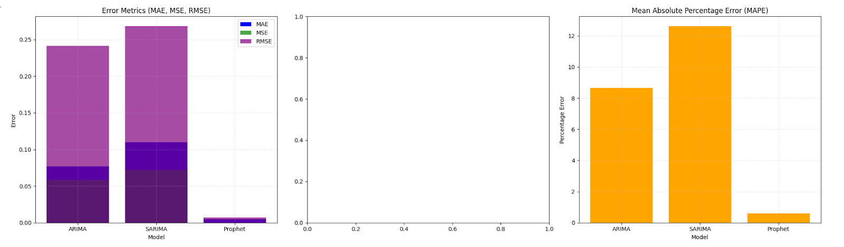
Error Metrics:
ARIMA: MAE: 0.0767, RMSE: 0.2413, MAPE:8.63%
SARIMA: MAE: 0.1100, RMSE: 0.2681, MAPE:12:63%
Prophet: MAE: 0.0051, RMSE: 0.0071, MAPE: 0.93%

Slide 14
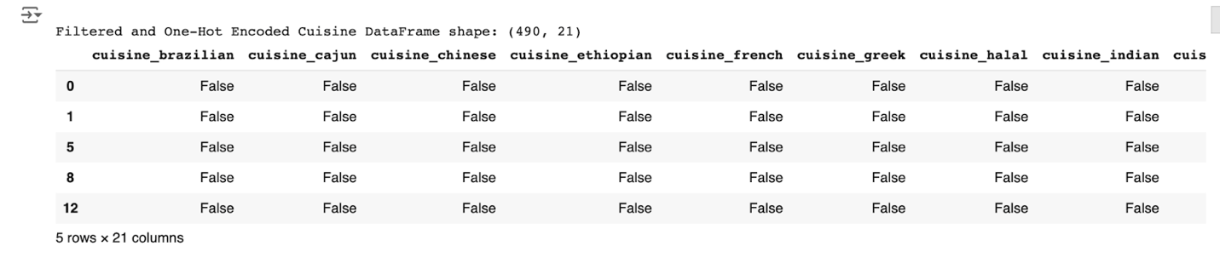
Research Question 3- Which cuisines are most popular among restaurants located near tourist spots? Objective: Identify popular cuisines in high-rated restaurants near tourist attractions in Edmonton. Focus: Filter restaurants with star ratings above 3.5. Using one-hot encoding, I transformed the 'cuisine' column into binary columns to prepare it for association rule mining.

Slide 15
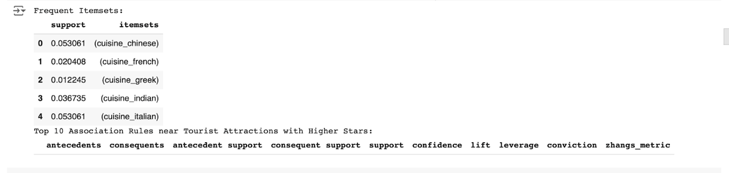
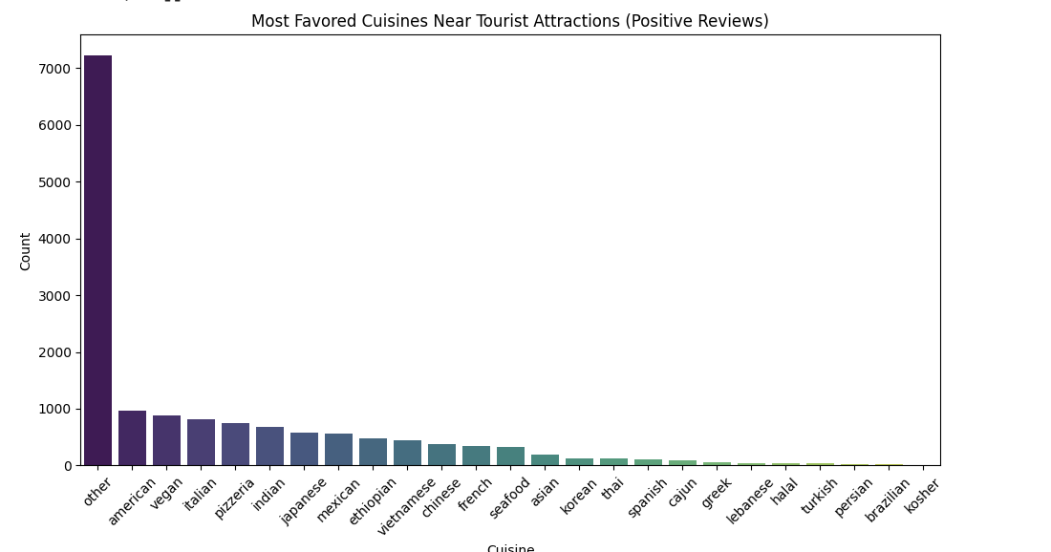
Outcome Chinese, Italian, and Indian were found frequently in high-rated restaurants near tourist spots.

Slide 16
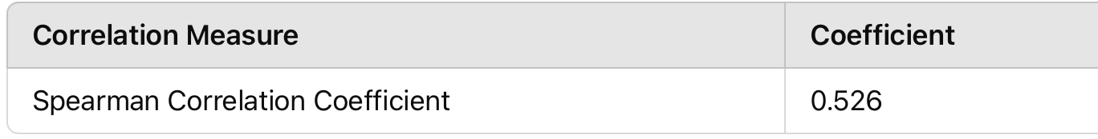
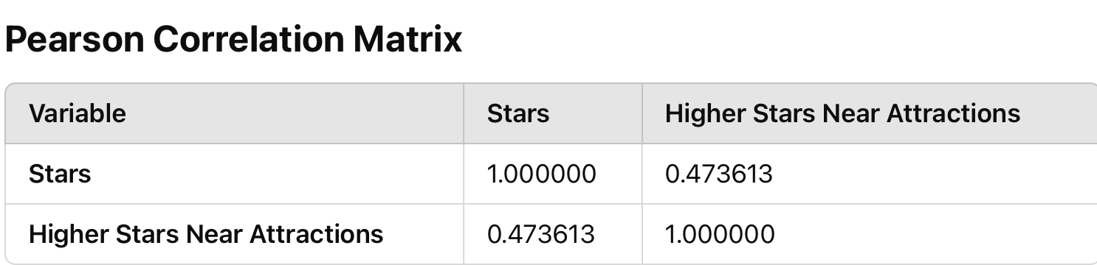
Research Question 4: What is the correlation between proximity to tourist attractions and star ratings?
Objective: Measure the correlation between restaurant proximity to tourist spots and star ratings.
Approach:
Used Pearson and Spearman correlation coefficients to analyze the relationship.

Slide 17
Outcome Results showed a moderate positive correlation, suggesting that restaurants closer to tourist attractions generally receive higher ratings, though other factors also contribute. Other Factors Influencing Ratings: Service Quality Food Quality: Online Visibility:

Slide 18
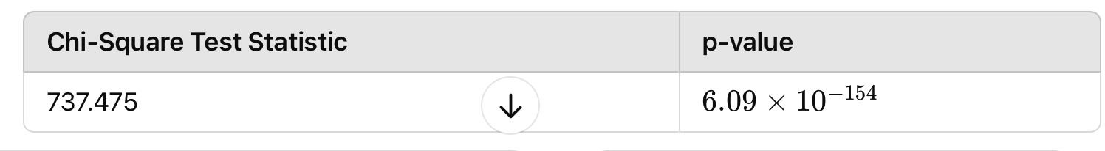
Research Question 5: Does the presence of high-rated restaurants near tourist attractions impact customer sentiment?
Objective: Examine if high-rated restaurants near tourist sites influence customer sentiment.
Approach:
Applied the Chi-square test to determine if there is a statistically significant relationship between restaurant ratings and proximity to tourist attractions.
Outcome:
The test confirmed a statistically significant relationship (p-value < 0.05), showing high-rated restaurants are frequently located near tourist areas.

Slide 19
Research Question 6: Which sentiment analysis models best capture customer sentiment trends for restaurants near tourist attractions, and how does feature engineering impact these predictions? Objective: Identify the best sentiment analysis models and evaluate the effect of feature engineering. .
Overall, BERT is the best-performing model due to its high accuracy and strong performance in both positive and negative sentiment predictions, despite struggling with neutral classification.

Slide 20
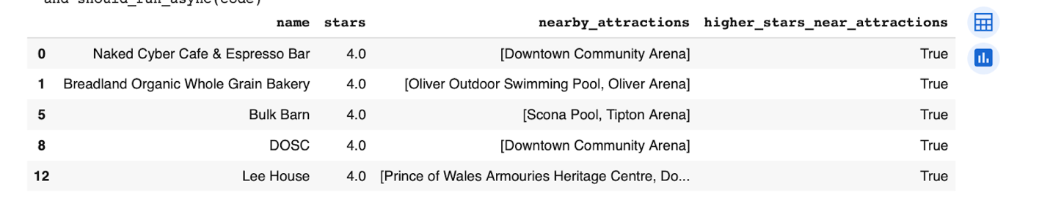
Approach: Feature Engineering: 1-Engineered the higher_stars_near_attractions feature using the Haversine formula to calculate proximity to tourist attractions. Added a binary contextual feature to the dataset.

Slide 21
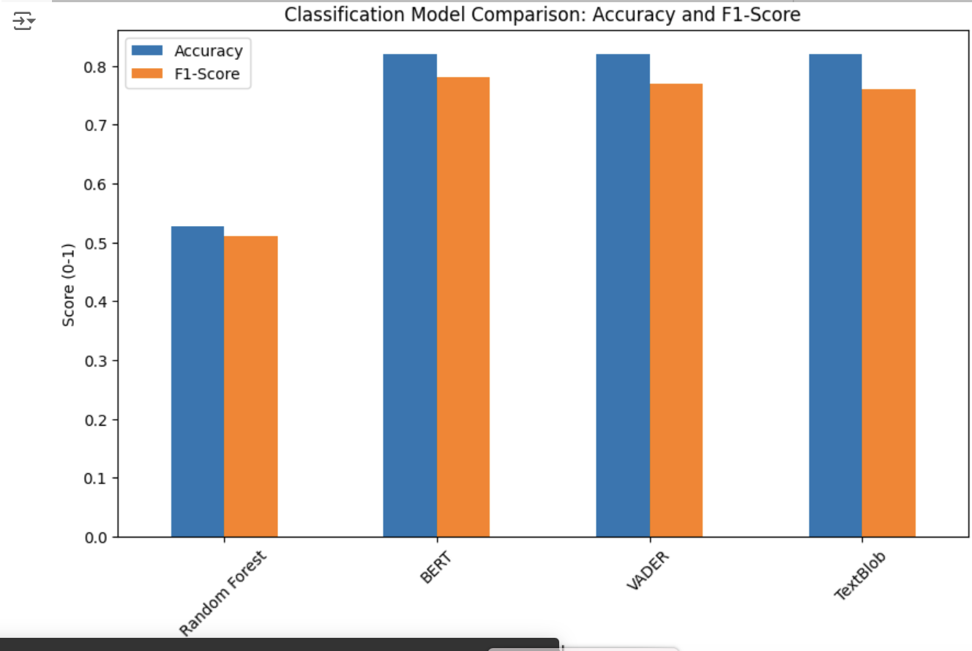
Model Comparison: Models: BERT, VADER, TextBlob, RandomForestClassifier. Used Optuna for RandomForestClassifier hyperparameter tuning. Applied TF-IDF to transform textual data for machine learning models.

Slide 22
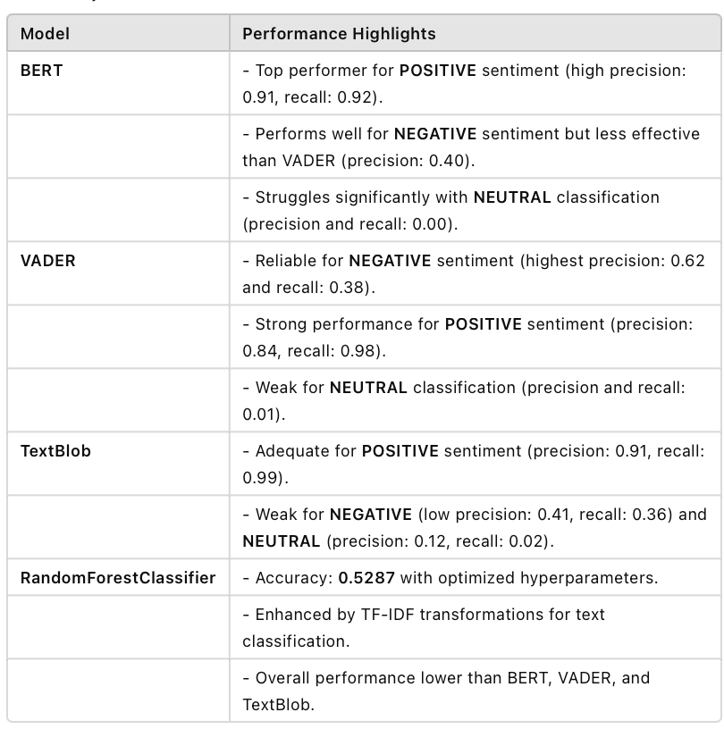

Slide 23
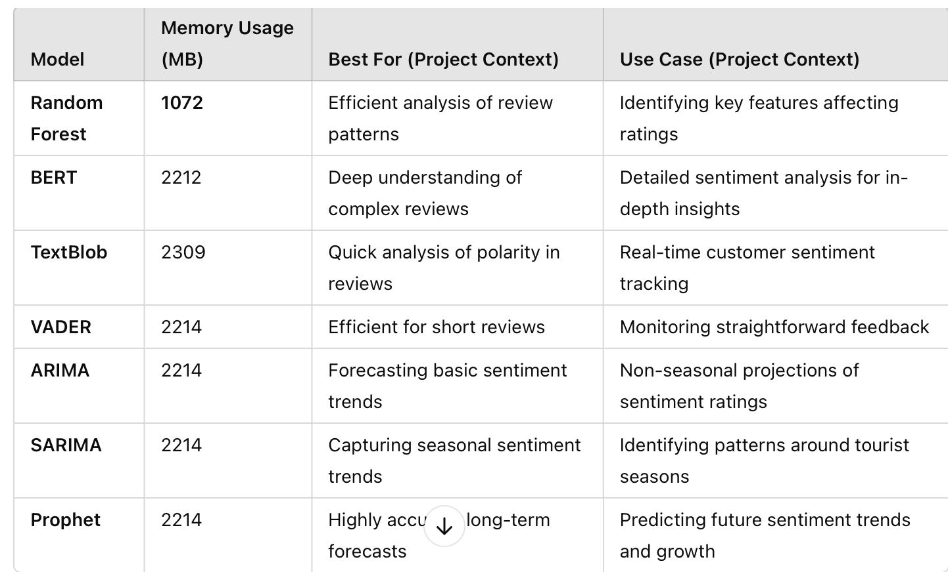
Memory Consumption Analysis
Objective
To evaluate and compare memory usage across models used in analyzing customer sentiment and forecasting future trends, ensuring optimal selection for Edmonton restaurants near tourist spots.

Slide 24
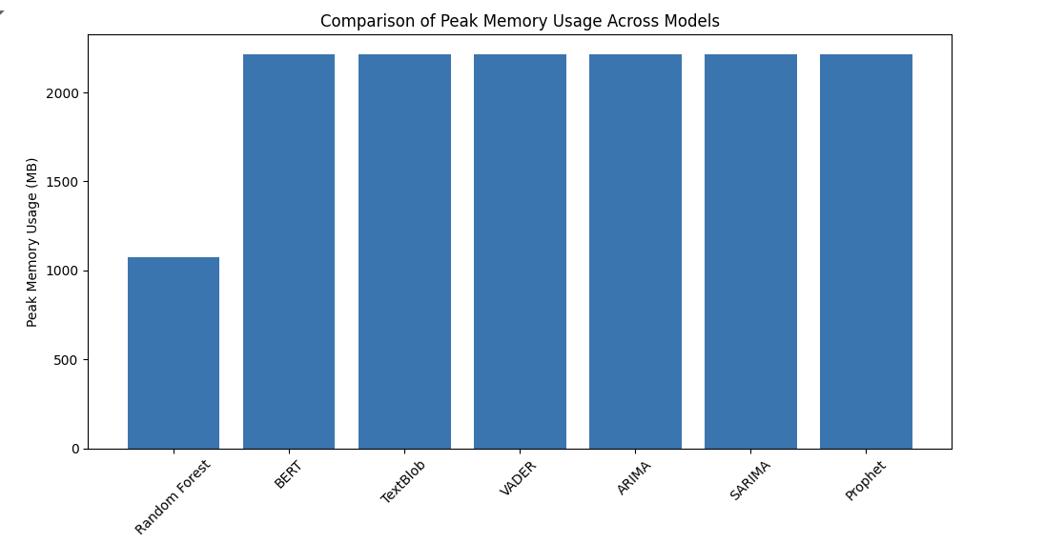
Memory Usage Comparison Across Sentiment and Forecasting Models

Slide 25
Why Is This Analysis Beneficial?
Resource Optimization:
Helps determine the most computationally efficient model for deployment based on available system resources.
Model Selection:
Guides stakeholders in choosing models aligned with project goals (e.g., detailed analysis, real-time applications, forecasting).
Strategic Insights:
Facilitates balanced decision-making between computational requirements and accuracy needs.

Slide 26
Conclusion This study bridges gaps in sentiment analysis and forecasting research by integrating:
Advanced Techniques
NLP Models: BERT, VADER, and TextBlob for nuanced sentiment analysis.
Machine Learning: Random Forest to identify key drivers of ratings.
Location-Based Insights
Developed higher_stars_near_attractions to analyze proximity effects on customer sentiment
Temporal and Statistical Analysis
Time-Series Models: ARIMA, SARIMA, Prophet to forecast sentiment trends.
Statistical Tests: Pearson, Spearman, and Chi-square to analyze location-sentiment relationships.

Slide 27
Actionable Insights and Recommendations
This project provides actionable insights for restaurant managers and tourism stakeholders.
Proximity to attractions significantly influences customer sentiment and ratings.
Supports better restaurant placement and service enhancements in tourist zones. Boosts customer satisfaction and tourism experiences through data-driven insights

Slide 28
References:
Agrawal, R., & Srikant, R. (1994). Fast algorithms for mining association rules. Proceedings of the 20th International Conference on Very Large Data Bases (pp. 487–499). VLDB Endowment. https://www.vldb.org/conf/1994/P487.PDF
Akiba, T., Sano, S., Yanase, T., Ohta, T., & Koyama, M. (2019). Optuna: A next-generation hyperparameter optimization framework. Proceedings of the 25th ACM SIGKDD International Conference on Knowledge Discovery & Data Mining (pp. 2623–2631).
Gao, L., Wang, Y., Wan, M., Li, Y., & Han, S. (2020). Interactive attention mechanism for aspect-level sentiment classification. arXiv preprint arXiv:2004.13851. https://ar5iv.labs.arxiv.org/html/2004.13851v1
Garcia, P., et al. (2019). Proximity and popularity: The role of location in online reviews. Tourism Economics, 25(2), 248–260.
Hutto, C. J., & Gilbert, E. (2014). VADER: A parsimonious rule-based model for sentiment analysis of social media text. Proceedings of the International AAAI Conference on Web and Social Media, 8(1), 216–225. https://ojs.aaai.org/index.php/ICWSM/article/view/14550/14399

Slide 29
References:
Hyndman, R. J., & Athanasopoulos, G. (2018). Forecasting: Principles and Practice. OTexts.
Joachims, T. (1998). Text categorization with support vector machines: Learning with many relevant features. European Conference on Machine Learning (pp. 137–142). Springer.
Kohavi, R. (1995). A study of cross-validation and bootstrap for accuracy estimation and model selection. Proceedings of the 14th International Joint Conference on Artificial Intelligence, 2, 1137–1143. Morgan Kaufmann.
Lin, I. Y., & Mattila, A. S. (2010). Restaurant atmosphere's impact on consumers' dining intentions: The moderating role of emotional well-being. International Journal of Hospitality Management, 29(3), 520–528.
Liu, B., Hu, M., & Cheng, J. (2019). Aggregated sentiment analysis of online customer reviews. Journal of Consumer Research, 46(5), 943–956.
Liu, B., Hu, M., & Cheng, J. (2019). Time-series analysis of customer sentiment and preference evolution. Journal of Marketing Analytics, 7(2), 147–160. https://doi.org/10.1016/j.jma.2019.05.001
Luca, M. (2016). Reviews, reputation, and revenue: The case of Yelp.com. Harvard Business School NOM Unit Working Paper No. 12-016.

Slide 30
References:
Namkung, Y., & Jang, S. (2007). Does food quality matter in restaurants? Its impact on customer satisfaction and behavioral intentions. Journal of Hospitality & Tourism Research, 31(3), 387–409.
Silverman, D. (2017). Doing qualitative research (5th ed.). Sage Publications.
Smith, J., & Lee, R. (2020). Geographic influence on customer satisfaction in the hospitality industry. Journal of Hospitality and Tourism Research, 42(3), 456–472.
Smith, L., & Lee, K. (2020). Location-based sentiment analysis in urban centers: Evaluating customer satisfaction and proximity effects. Journal of Consumer Research, 46(4), 389–408. https://doi.org/10.1093/jcr/ucz037
Taylor, S. J., & Letham, B. (2018). Forecasting at scale. The American Statistician, 72(1), 37–45. https://doi.org/10.1080/00031305.2017.1380080

Slide 31
References:
Vaswani, A., Shazeer, N., Parmar, N., Uszkoreit, J., Jones, L., Gomez, A. N., ... & Polosukhin, I. (2017). Attention is all you need. Advances in Neural Information Processing Systems (pp. 5998–6008). https://arxiv.org/abs/1706.03762
Xiao, W., Wei, X., Zhang, Y., & Shi, Y. (2023). Sentiment analysis for tourism using transformer-based models. Applied Sciences, 13(7), 4550. https://doi.org/10.3390/app13074550
Yelp Inc. (2021). Yelp Open Dataset. https://www.yelp.com/dataset
Zhang, X., Hou, W., & Li, Y. (2021). The impact of service quality on customer satisfaction and behavioral intentions. Journal of Hospitality Management, 47(3), 25–34
Yelp Inc. (2021). Yelp Open Dataset. https://www.yelp.com/dataset
City of Edmonton Open Data Portal (2021). Edmonton Tourist Attractions Dataset. https://data.edmonton.ca
Note: The datasets used in this analysis are subject to the terms and conditions of the respective licences. The Yelp Open Dataset is used under the Yelp Dataset License Agreement, and the Edmonton Tourist Attractions Dataset is used under the Open Government License - City of Edmonton.

Slide 32
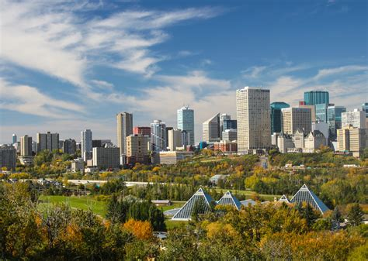
Thank You, Professor!
I appreciate your guidance and support throughout this project.
Looking forward to your feedback and suggestions!

